Slide 1

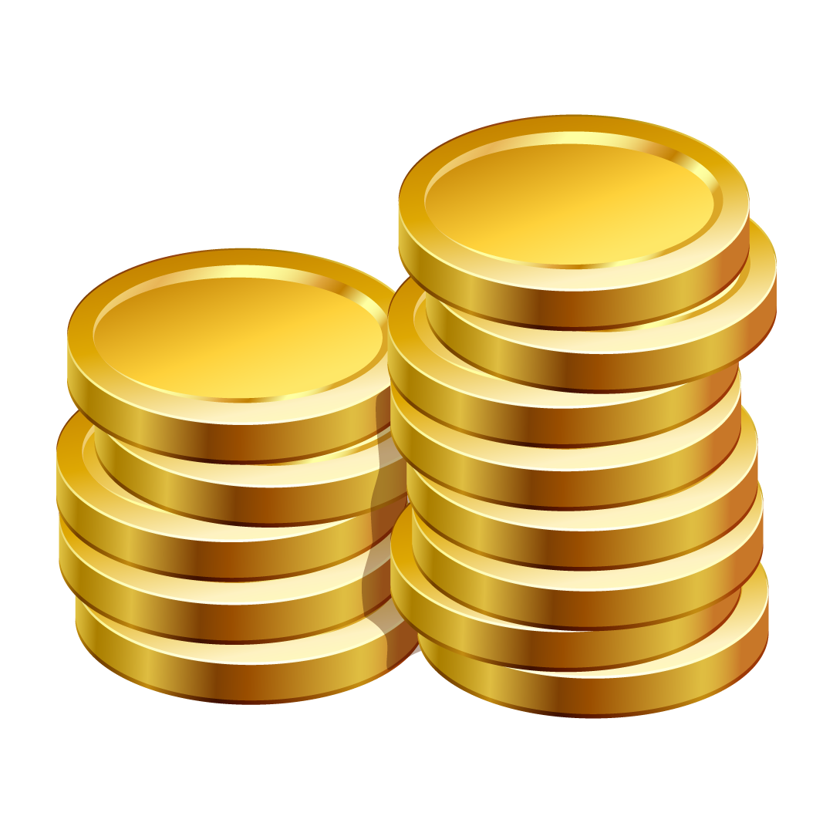
ACCOUNTING SERVICES
COMPANY PROFILE
Here is where your presentation begins

Slide 2
CONTENTS OF THIS TEMPLATE
You can delete this slide when you’re done editing the presentation
Fonts | To view this template correctly in PowerPoint, download and install the fonts we used
Used and alternative resources | An assortment of graphic resources that are suitable for use in this presentation
Thanks slide | You must keep it so that proper credits for our design are given
Colors | All the colors used in this presentation
Icons and infographic resources | These can be used in the template, and their size and color can be edited
Editable presentation theme | You can edit the master slides easily. For more info, click here
For more info:
SLIDESGO | BLOG | FAQs
You can visit our sister projects:
FREEPIK | FLATICON | STORYSET | WEPIK | VIDEVO

Slide 3
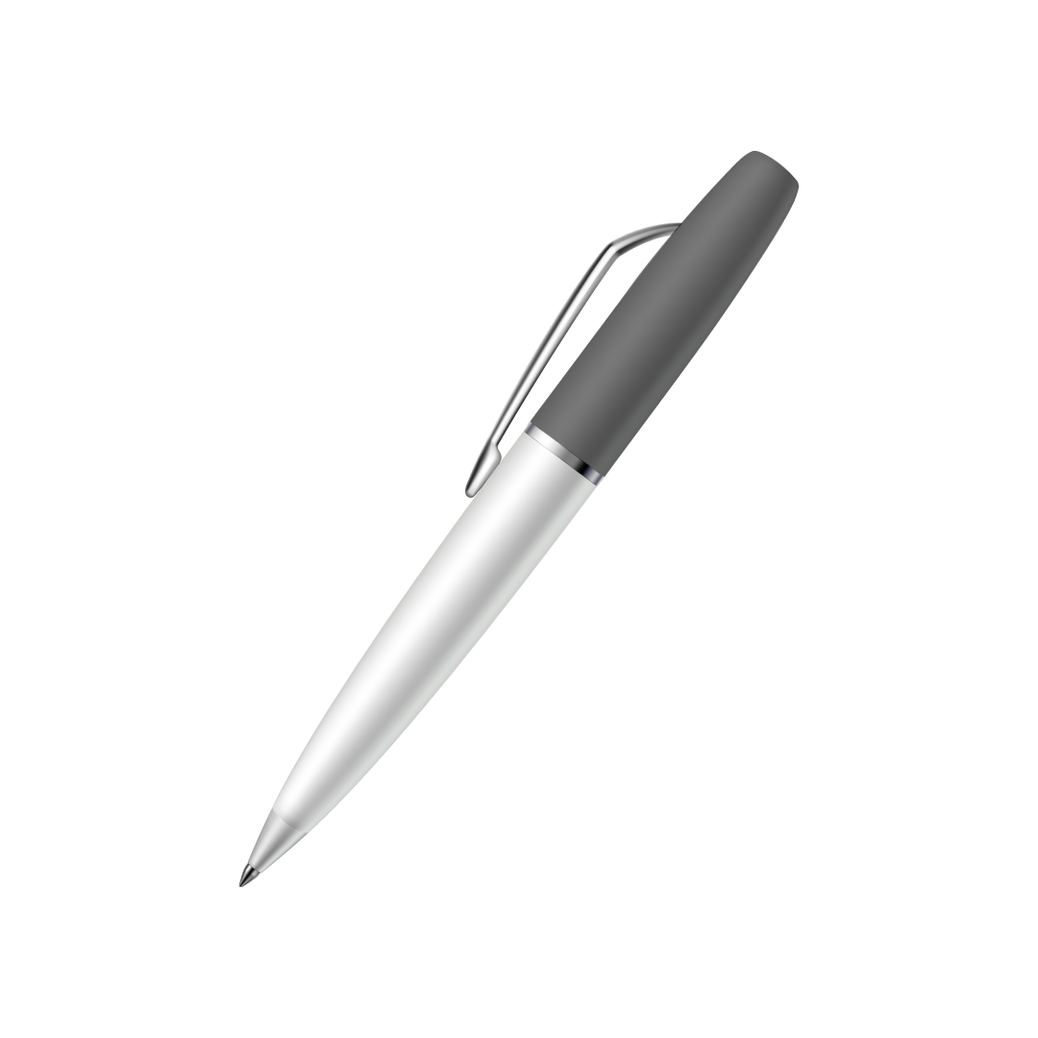
TABLE OF CONTENTS
01
COMPANY
02
SERVICES
03
CLIENTS
04
PROJECTION
You can describe the topic of the section here
You can describe the topic of the section here
You can describe the topic of the section here
You can describe the topic of the section here

Slide 4

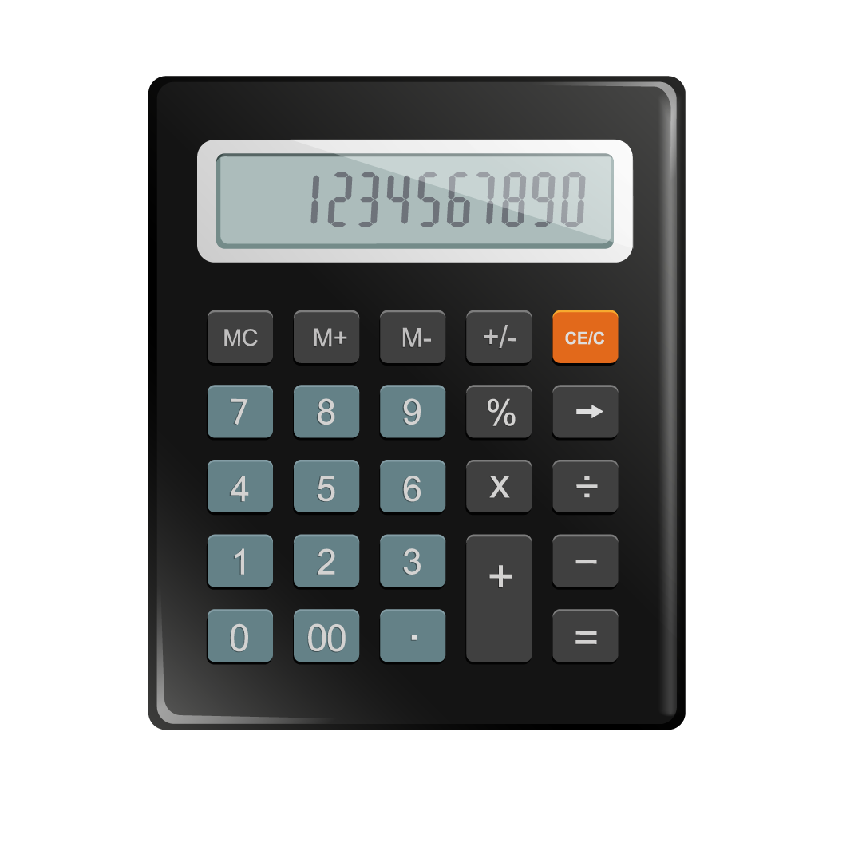
ABOUT US
Do you know what helps you make your point clear? Lists like this one:
They’re simple
You can organize your ideas clearly
You’ll never forget to buy milk!
You can replace the image. Just right-click on it and select “Replace image”

Slide 5
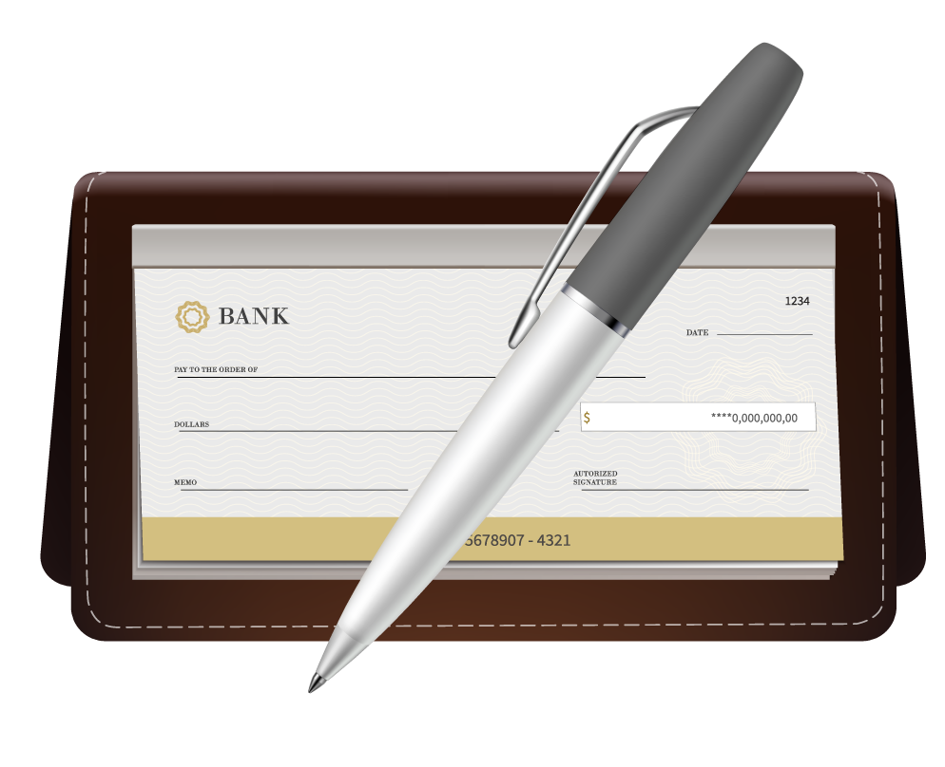
01
COMPANY
You can enter a subtitle here if you need it

Slide 6
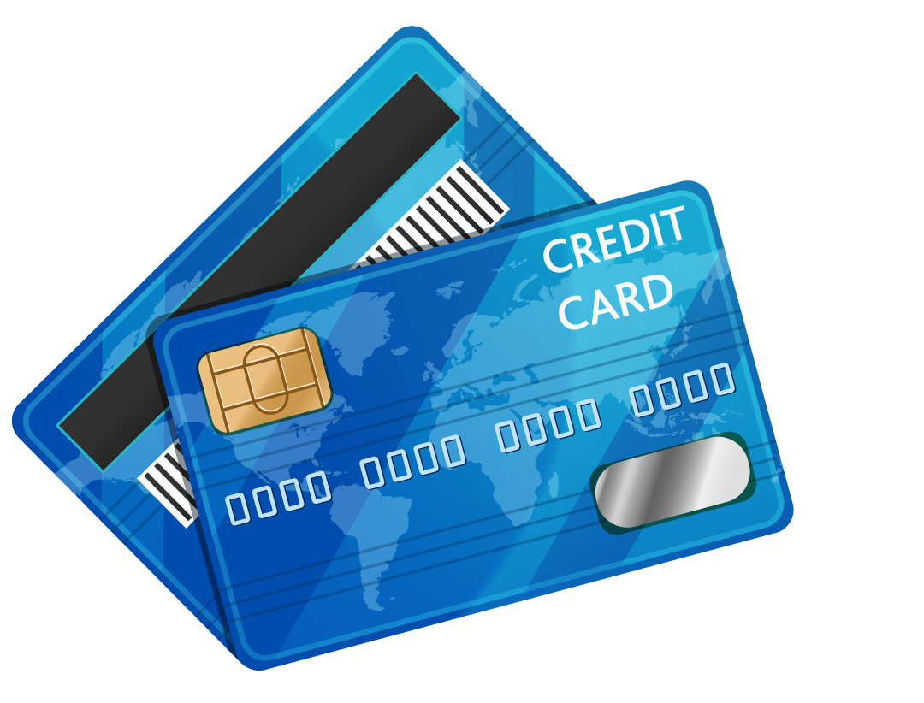
TWO IDEAS
MERCURY
Mercury is the closest planet to the Sun and the smallest one in the Solar System—it’s only a bit larger than the Moon. The planet’s name has nothing to do with the liquid metal, since Mercury was named after the Roman god
VENUS
Venus has a beautiful name and is the second planet from the Sun. It’s terribly hot—even hotter than Mercury—and its atmosphere is extremely poisonous. It’s the second-brightest natural object in the night sky after the Moon

Slide 7
THREE IMPORTANT IDEAS
MERCURY
Mercury is the closest planet to the Sun and the smallest one in the Solar System. This planet's name has nothing to do with the liquid metal, since Mercury was named after the Roman messenger god
VENUS
Venus has a beautiful name and is the second planet from the Sun. It’s terribly hot, even hotter than Mercury, and its atmosphere is extremely poisonous. It’s the second-brightest natural object in the night sky
JUPITER
Jupiter is a gas giant and the biggest planet in the Solar System. It's the fourth-brightest object in the night sky. It was named after the Roman god of the skies and lightning

Slide 8
FOUR IDEAS
MARS
VENUS
Despite being red, Mars is actually a cold place. It's full of iron oxide dust, which gives the planet its reddish cast, and it’s made of basalt
Venus has a beautiful name and is the second planet from the Sun. It’s terribly hot and has a very poisonous atmosphere
JUPITER
SATURN
Jupiter is a gas giant and the biggest planet in the Solar System. It's the fourth-brightest object in the night sky and named after a Roman god
Saturn is a gas giant and has several rings. It's composed mostly of hydrogen and helium. It’s the sixth planet from the Sun

Slide 9
SIX IDEAS
MARS
VENUS
NEPTUNE
Despite being red, Mars is actually a cold place. It's full of iron oxide dust, which gives the planet its reddish cast
Venus has a beautiful name and is the second planet from the Sun. It’s terribly hot, even hotter than Mercury
Neptune is the farthest planet from the Sun. It's also the fourth-largest planet by diameter in the Solar System
EARTH
SATURN
JUPITER
Earth is the third planet from the Sun and the only one that harbors life in the Solar System. We all live on this planet
Saturn is a gas giant and has rings. It's composed mostly of hydrogen and helium. It’s the sixth planet from the Sun
Jupiter is a gas giant and the biggest planet in the Solar System. It's the fourth-brightest object in the night sky

Slide 10
4,498,300,000
Big numbers catch your audience’s attention

Slide 11

A PICTURE IS WORTH A THOUSAND WORDS

Slide 12
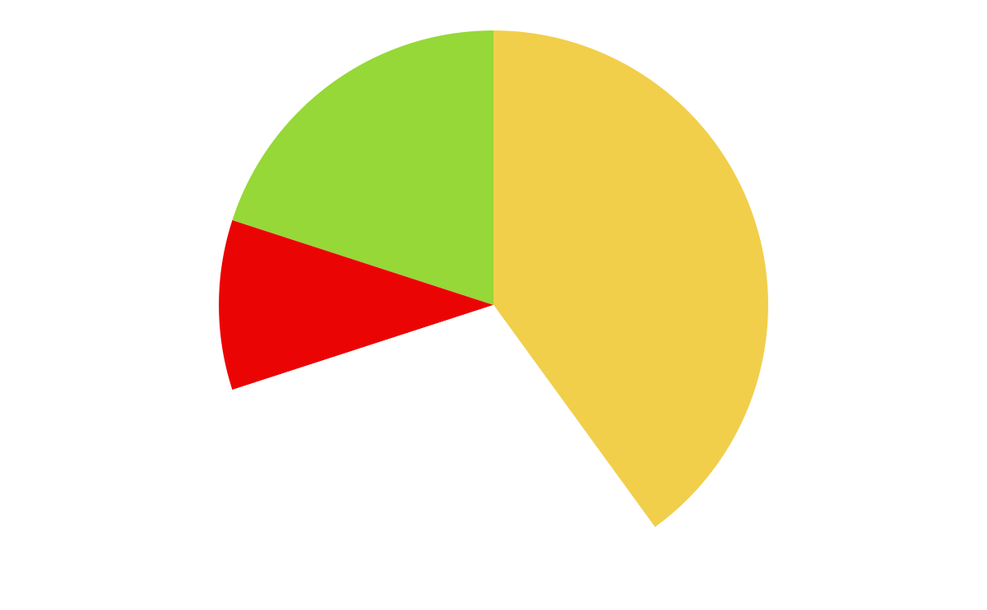
PIE CHART
10%
Q1
Mars is very cold
20%
Q2
Mercury is small
40%
Q3
Venus is very hot
30%
Q4
Earth has life
Follow the link in the graph to modify its data and then paste the new one here. For more info, click here

Slide 13
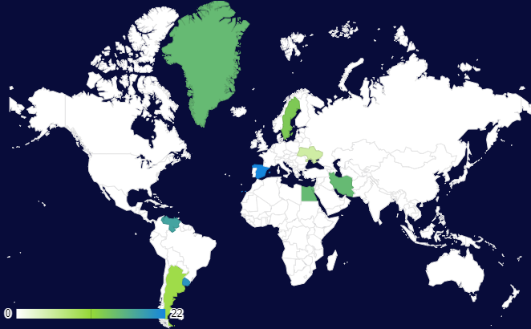
MAP
MARS
Despite being red, Mars is actually a cold place
MERCURY
Mercury is the closest planet to the Sun
VENUS
Venus is terribly hot, even hotter than Mercury
Follow the link in the graph to modify its data and then paste the new one here. For more info, click here

Slide 14
NEXT PROJECTS
 | TEAM A | TEAM B | TEAM C | TEAM D | TEAM E | TEAM F
MERCURY | XX | XX | XX | XX | XX | XX
VENUS | XX | XX | XX | XX | XX | XX
EARTH | XX | XX | XX | XX | XX | XX
MARS | XX | XX | XX | XX | XX | XX
JUPITER | XX | XX | XX | XX | XX | XX
SATURN | XX | XX | XX | XX | XX | XX

Slide 15
TIMELINE
WEEK 1
WEEK 3
Mercury is the closest planet to the Sun
Despite being red, Mars is a very cold place
WEEK 2
WEEK 4
Venus is the second planet from the Sun
Earth is the third planet from the Sun

Slide 16
TARGET INFOGRAPHIC
DEMOGRAPHIC
BEHAVIOR
GEOGRAPHIC
Age
25-50 years old
Mercury is the closest planet to the Sun and the smallest one
Venus has a beautiful name and is the second planet from the Sun
Despite being red, Mars is actually a cold place. It’s full of iron oxide dust
Gender
Male and female
Occupation
Employees and students
Family situation
Single and married people
Region
Europe, Asia
Area
Urban
Income
$50,000/year
Follow the link in the graph to modify its data and then paste the new one here. For more info, click here

Slide 17
ORGANIZATIONAL CHART
CHIEF FINANCIAL OFFICER
ADMINISTRATIVE
TREASURY
ACCOUNTANT
OFFICE STAFF
MUNICIPAL AUTHORIZED
MUNICIPAL CASHIER

Slide 18
ROADMAP INFOGRAPHIC
TASK | JAN | FEB | MAR | APR | MAY | JUN | JUL | AUG | SEP | OCT | NOV | DEC
Venus is the second planet from the Sun
Earth is the beautiful planet on which we live
Despite being red, Mars is actually a cold place
Jupiter is the biggest planet of them all
Saturn is a gas giant and has several rings
Finished
In progress
Approved
Waiting for approval

Slide 19


PHOTO SHOWCASE
You can replace the images on the screen with others. Just right-click on any of them and select “Replace image”

Slide 20

THANKS!
Do you have any questions?
youremail@freepik.com
+34 654 321 432
yourwebsite.com
Please keep this slide for attribution

